Slide 1
Customise your personal Data Science Assistant Bot
STATWORX GmbH
Livia Eichenberger
Oliver Guggenbühl
useR! 2021 The R Conference
Elevator Pitch
Zurich, 6 July 2021

Slide 2



WHO WE ARE
We Are Two Creative Data Scientists from STATWORX Who Want to Make AI Accessible to Everyone.
LIVIA EICHENBERGER
Team leader of the AI & Society Initiative, which aims at analysing, addressing and discussing the impact of AI on society and educating the population about the chances and risks of AI.
OLIVER GUGGENBÜHL
Data Scientist and Content Writer who is particularly passionate about visual and interactive storytelling with data. He is an expert in building creative Shiny dashboards and applications.
STATWORX GmbH is a consulting and development company for data science, machine learning and AI based in Frankfurt and Zurich.
Notes:
Stichpunkte, Bullet Points, Aufzählung, Subpoints, Unterthemen

Slide 3
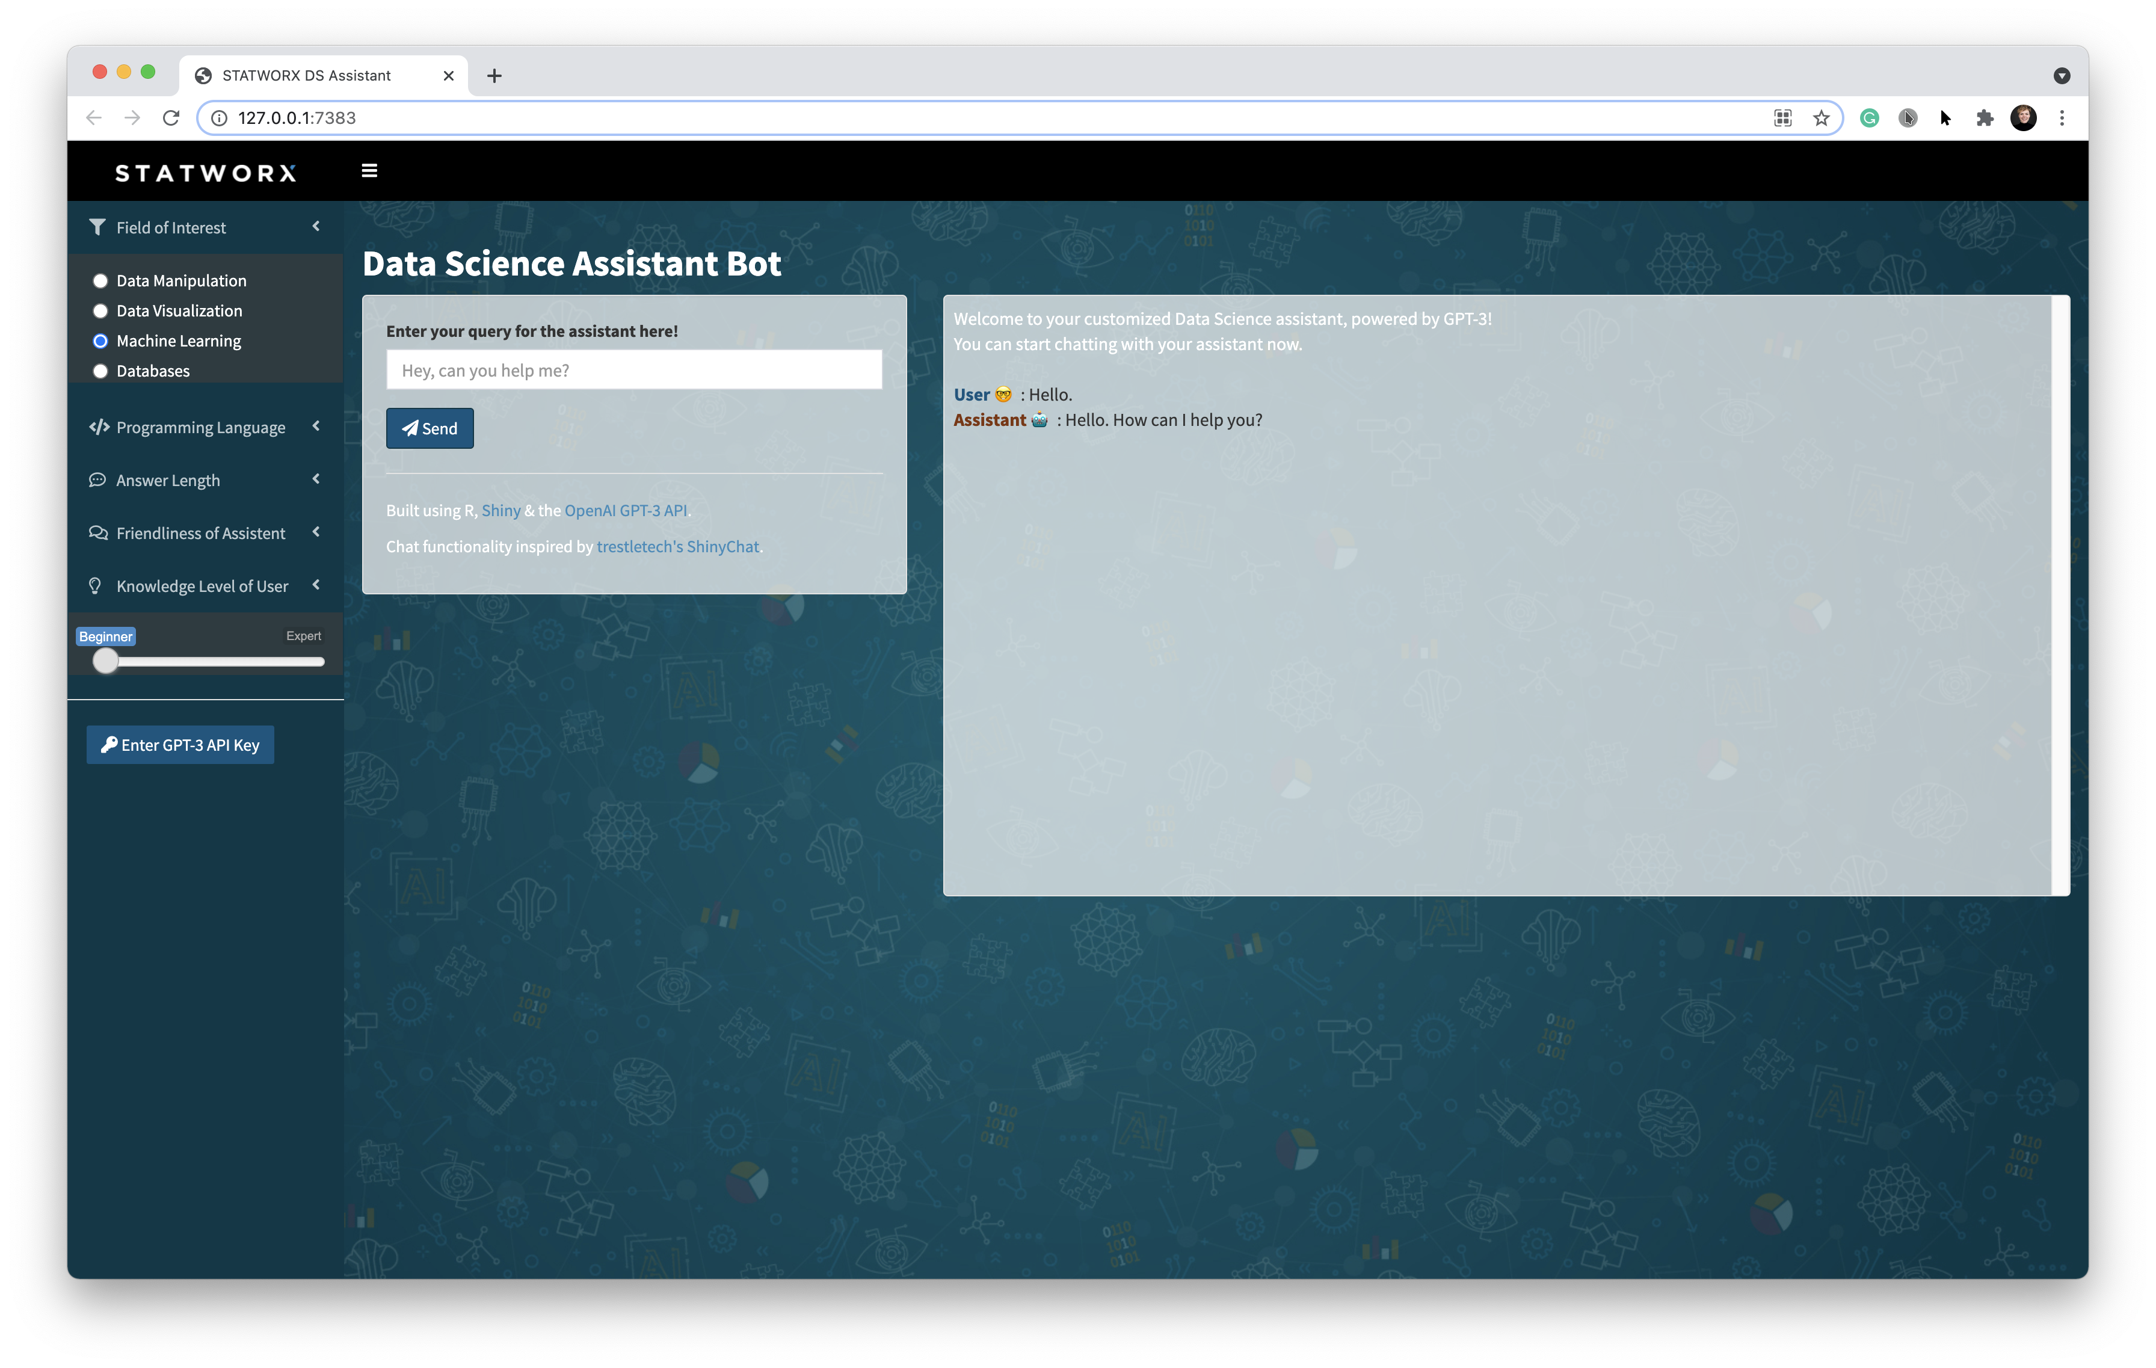
OUR DATA SCIENCE CHATBOT
A Shiny Interface for GPT-3 to Simply and Quickly Customize Your Data Science Assistant Bot.
CUSTOMISATION
Adapt chatbot to your needs
Set parameters of chatbot‘s behaviour
No coding required, only point and click
Change assistant on the fly
CHAT
Chat with the customised assistant
Receive answer immediately
The whole chat history is shown
GPT-3
NLP – Autoregressive language model
Developed by OpenAI in 2020
Test version for selected users
Generation of human-like text
Different use cases available
Chatbot, text summarisation, Q&A
Accessible via API

Slide 4


CHATBOT DESIGN
The Data Science Assistant Bot is based on the «Text In, Text Out» Interface of the Model’s API.
A new user question
triggers an API request
AI CHATBOT DESCRIPTION
SHINY APP
OPENAI API
WHOLE CHAT HISTORY
TEXT IN
API Request
NEW USER QUESTION
CHATBOT ANSWER
TEXT OUT
API Response
Notes:
Stichpunkte, Bullet Points, Aufzählung, Subpoints, Unterthemen

Slide 5
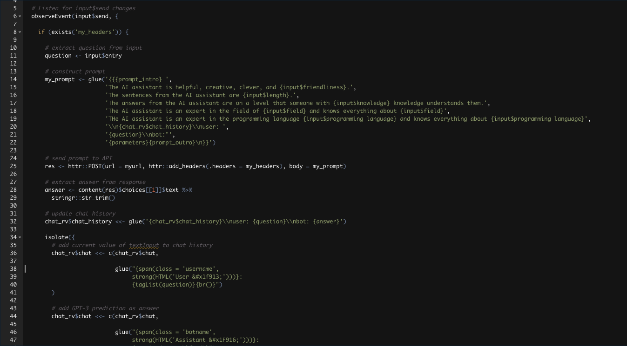
SHINY Implementation
With Shiny, the Interactive Customisation of the Data Science Assistant Bot Is Easier Than Ever.
CUSTOMISATION PARAMETERS
The description of the chatbot is sent as a long string
Shiny‘s inputs are used to change this by selecting parts of the string via inputs
PACKAGES
Shiny
ShinyDashboard
ShinyWidgets
ShinyAlter
stringr
glue
httr
BACKEND
Inspired by testletech‘s ShinyChat
ShinyChat stores the entire chat history as one long string
This is perfectly aligned with the necessary API request (Text In)

